Slide 1
Cloud Based TASKI Machine
Need for a multi-functional system for TASKI machines to facilitate improvement in monitoring, performance and safety.
We propose a cloud based TASKI machine which will be monitored continuously in terms of location, transportation speed, brush speed, battery temperature, ambient humidity, chemical solution/ water tank level, etc.
If anomalies are detected, real time alerts will be generated which will facilitate diagnostic services. For security, theft tracking will also be handled.
Sunny Bangale | Shwetali Mahajan | Abhijeet Bhatikar

Slide 3









Geo Fencing
Real Time Alerts
Battery Management
GPS Tracking
Theft Tracking
Dashboard and Analysis
Customized Alerts
Chemical Solution Details

Slide 4
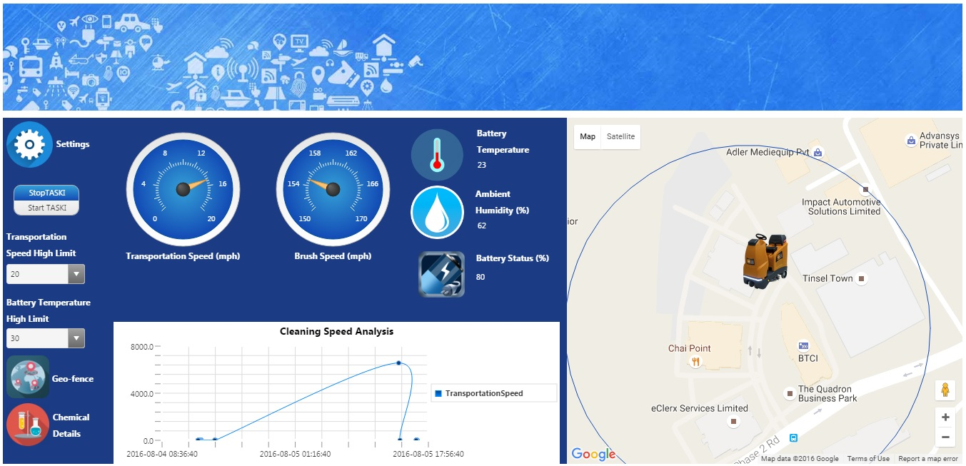

Slide 5
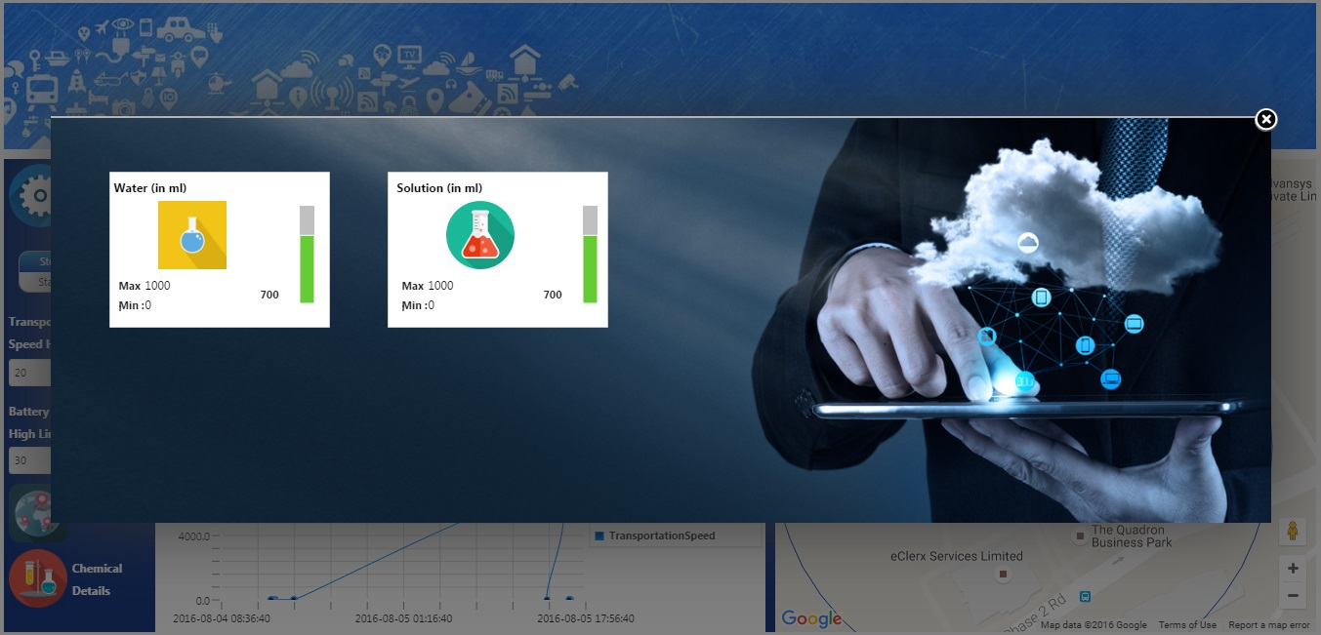

Slide 6
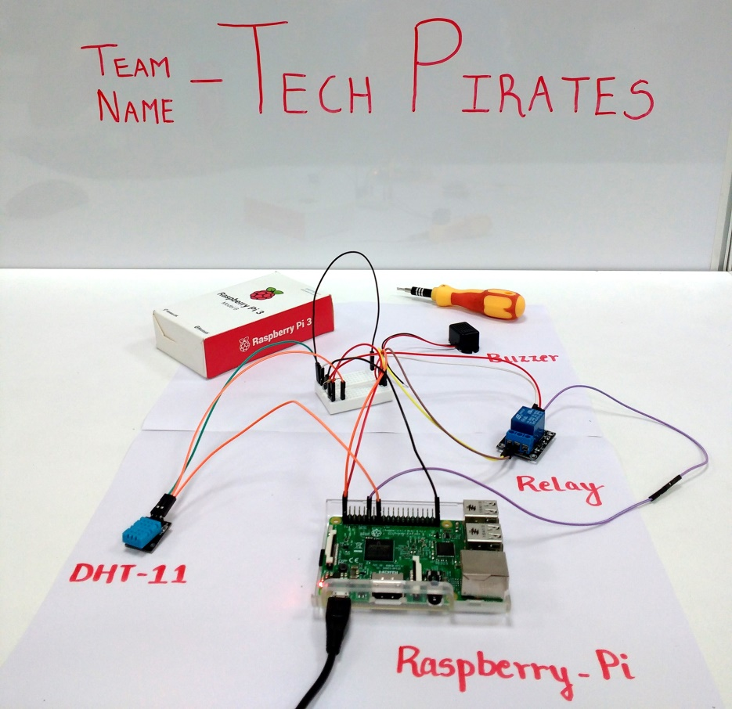

Slide 7
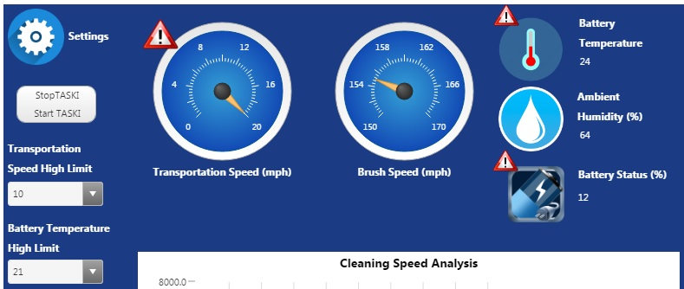

Slide 8
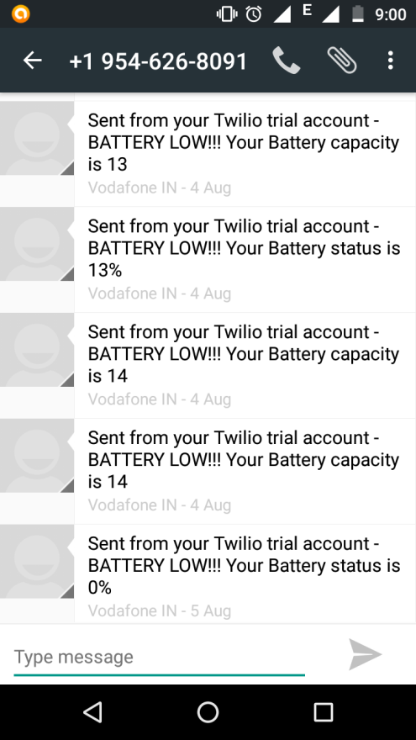
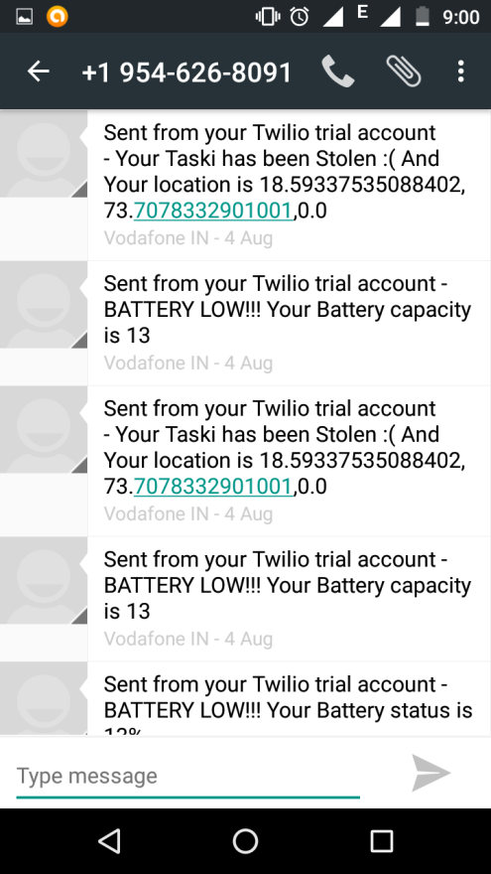
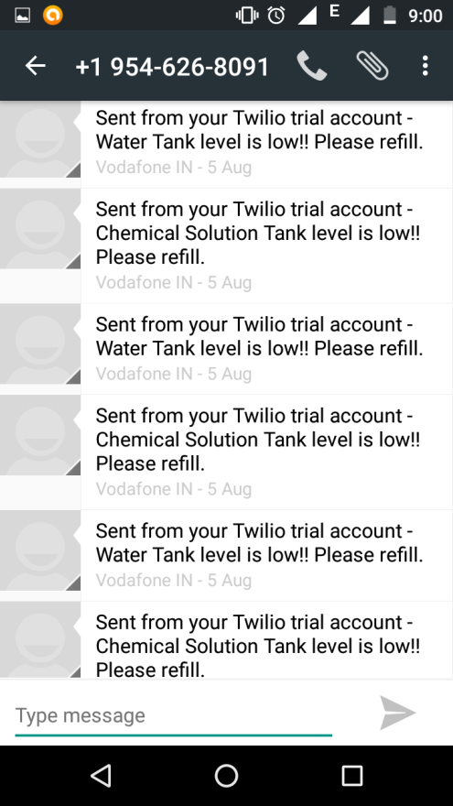

Slide 9
Thank You

